Slide 1

CS 584 Machine Learning
Week 12
November 7, 2018

Slide 2

Week 12 Agenda
Support Vector Machine
Chapter 13 of the Machine Learning book

Slide 3
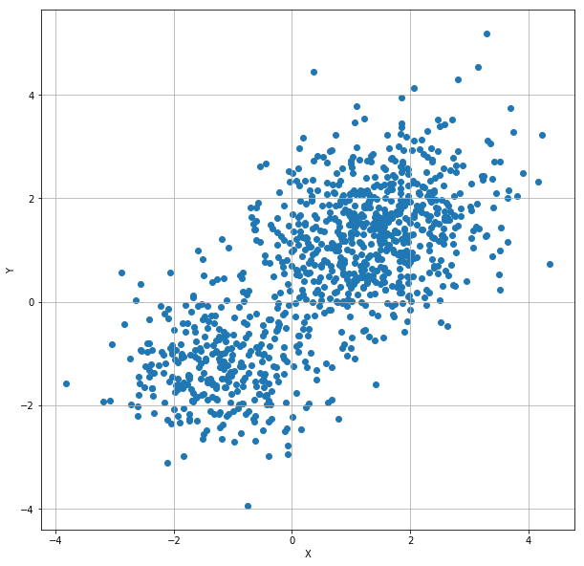
A Classification Problem
1,000 observations
Interval features: X and Y
If I tell you that these points come from two multivariate normal populations, then how will you divide these points into two groups?

Slide 4
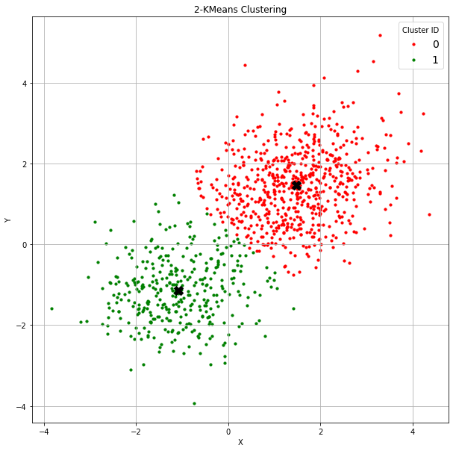
K-Means Algorithm Revisited
You may apply the K-means clustering algorithm to find two clusters.
The Centroids, marked X in the chart, are: [[ 1.46733873 1.46039557] [-1.08297405 -1.14699599]]
Do you think the clustering algorithm has done a good job in classifying the observations?

Slide 5

A Supervised Classification Problem
I supposedly know the prior grouping information.
Some red points mingled with the green points.
Can you develop a classifier that classifies each observation into one of the two classes?

Slide 6
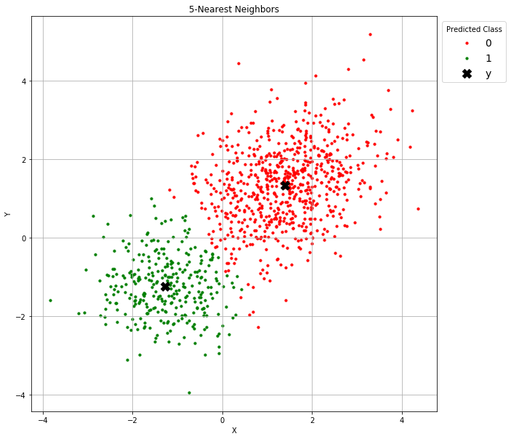
Nearest Neighbor Algorithm Revisited
You may try the nearest neighbors classifier.
Suppose I consider the 5-neighbors solution
The means of the predicted class, marked X in the chart, are: [[ 1.389441 1.338608] [-1.271928 -1.245927]]
The mean accuracy is 0.977
Do you think the nearest neighbor algorithm has done a good job in classifying the observations?

Slide 7

Multinomial Logistic Algorithm Revisited
You may try the multinomial logistic model classifier.
The means of the predicted class, marked X in the chart, are: [[ 1.371424 1.337239] [-1.274450 -1.285303]]
The mean accuracy is 0.976
Do you think the multinomial logistic algorithm has done a good job in classifying the observations?

Slide 8
True Populations Revealed
 | Means of Population 1 |  | Mean of Population 2
 | x | y | x | y
K-Means | 1.4673 | 1.4604 | -1.0830 | -1.1470
5-Nearest Neighbor | 1.3894 | 1.3386 | -1.2719 | -1.2459
Multinomial Logistic | 1.3714 | 1.3372 | -1.2745 | -1.2853
True | 1.3 | 1.3 | -1.3 | -1.3
Comments:
Without any prior information about The multinomial logistic model and the 5-Nearest Neighbor model have practically the same accuracy (0.976 vs. 0.977), but the former model better predicts the population means.
the target variable, it is not unexpected to see poorer estimates of the population means from the K-means algorithm

Slide 9
Predictions of Algorithms
K-Means is a “Follow the Leaders” prediction. The leaders are the clusters’ centroids. An observation is assigned to the cluster if the observation is closest to the cluster’s centroid.
Nearest Neighbor is a “Go Along with the Crowd” prediction. The crowd consists of the neighbors. An observation takes the majority opinion of the crowd.
Multinomial Logistic is a “Personality Test” prediction. Each attribute of an observation individually contributes a weight to the logit (i.e., log-odds) of belonging to a particular population.

Slide 10
Pros and Cons of Predictions of Algorithms
Algorithm | Pros | Cons
K-Means | Only need to know the centroids for prediction | The predictions are reliable only if the number of clusters is correct. Need to calculate the distance metric.
Nearest Neighbor | Only need to know the number of neighbors. A instance/memory-based learning model | The predictions are reliable only if the number of neighbors is correct for every observation. Need to calculate the distance metric. Need to carry the whole training data for prediction.
Multinomial Logistic | Only need to know the parameter estimates (i.e., the weights). Allows us to visualize the impacts of the attributes on the predictions. | Correlations among attributes have to be explicitly specified in the model. May suffer from non-convergence and floating-point numerical problems.

Slide 11
Draw-A-Line-In-The-Sand Prediction
Goal: Correct classification of observations
Don’t
Need to know the characteristics (e.g., means ) of the populations
Need to know the likelihood of belonging to a population
Want to carry a training data everywhere for prediction
Want to calculate the distance metric or the logit
Do
Work well for future observations
Require only simple arithmetic calculations for prediction
Support Vector Machines (SVM) offer a “Draw a Line in the Sand” prediction

Slide 12
History of Support Vector Machines
The original Support Vector Machines algorithm was invented in 1963 by Vladimir Naumovich Vapnik (1936-present) and Alexey Yakovlevich Chervonenkis (1938-2014) at the Institute of Control Sciences of the Russian Academy of Sciences, Moscow, Russia.
In 1992, Bernhard E. Boser, Isabelle M. Guyon and Vladimir N. Vapnik suggested an improvement on the original support vector machine which allows for the creation of nonlinear classifiers.
https://www.kdnuggets.com/2016/07/guyon-data-mining-history-svm-support-vector-machines.html
https://link.springer.com/chapter/10.1007%2F978-3-642-41136-6_3

Slide 13
Overview of Support Vector Machines
A Support Vector Machine is a discriminative classifier formally defined by a separating hyperplane.
A Support Vector Machine is a large-margin linear classifier.
Support Vector Machines become popular because it can successfully solve many classification problems.
A machine is a device or an algorithm that performs a particular task (classification in this case) with a definite goal.

Slide 14
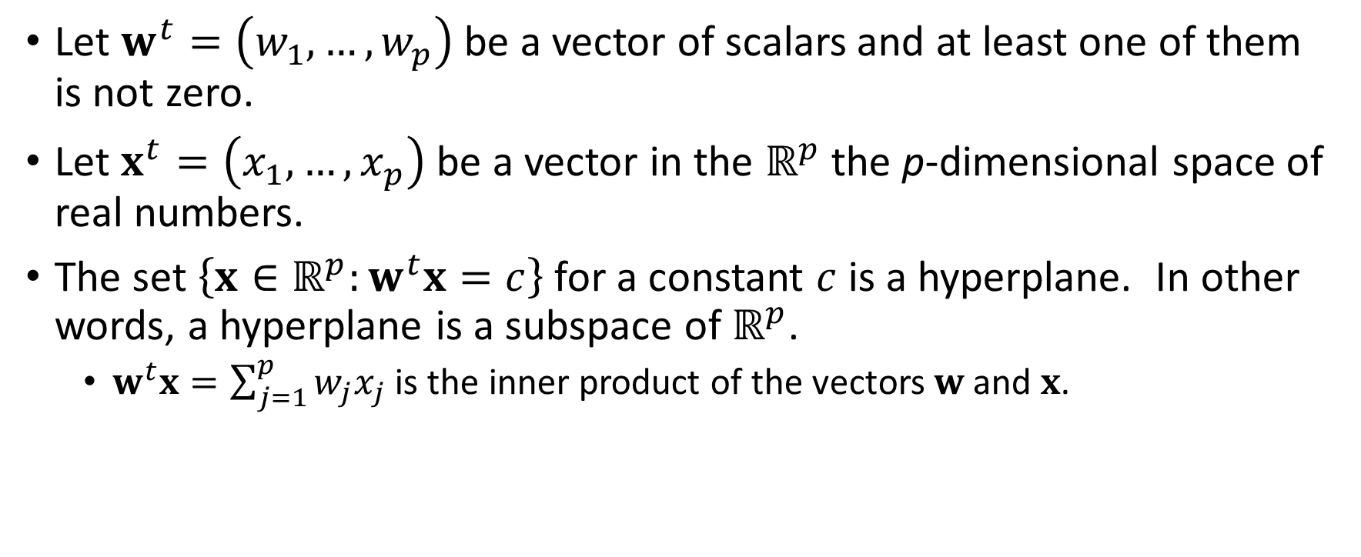
What is a Hyperplane?
Let $w^{t}=\left(w_{1},…,w_{p}\right)$ be a vector of scalars and at least one of them is not zero.
Let $x^{t}=\left(x_{1},…,x_{p}\right)$ be a vector in the $ℝ^{p}$ the p-dimensional space of real numbers.
The set $\left\{x∈ℝ^{p}:w^{t}x=c\right\}$ for a constant $c$ is a hyperplane. In other words, a hyperplane is a subspace of $ℝ^{p}$.
$w^{t}x=\sum_{j=1}^{p}{w_{j}x_{j}}$ is the inner product of the vectors $w$ and $x$.

Slide 15
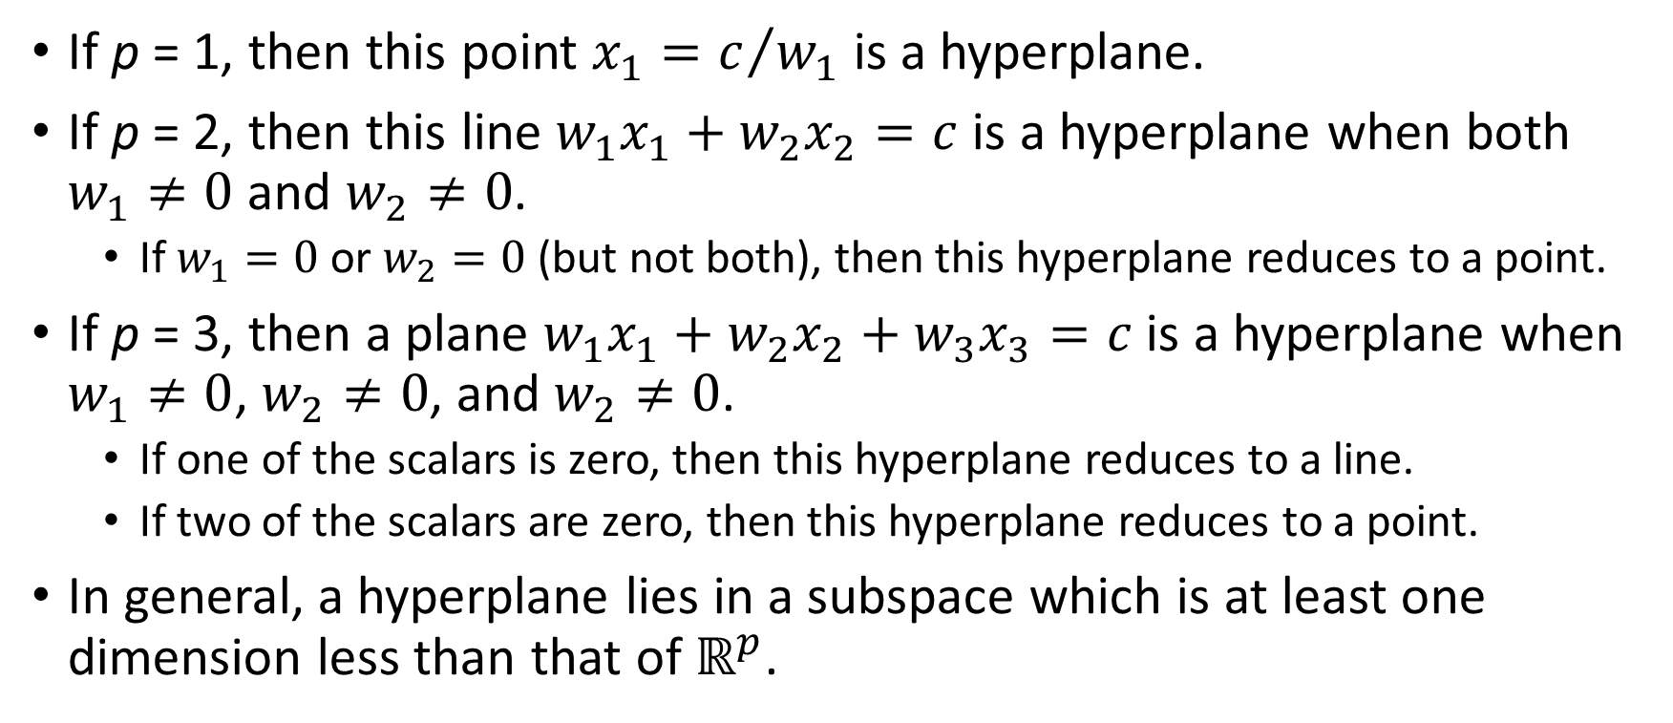
Examples of a Hyperplane
If p = 1, then this point $x_{1}=c/{w_{1}}$ is a hyperplane.
If p = 2, then this line $w_{1}x_{1}+w_{2}x_{2}=c$ is a hyperplane when both $w_{1}≠0$ and $w_{2}≠0$.
If $w_{1}=0$ or $w_{2}=0$(but not both), then this hyperplane reduces to a point.
If p = 3, then a plane $w_{1}x_{1}+w_{2}x_{2}+w_{3}x_{3}=c$ is a hyperplane when $w_{1}≠0$, $w_{2}≠0$, and $w_{2}≠0$.
If one of the scalars is zero, then this hyperplane reduces to a line.
If two of the scalars are zero, then this hyperplane reduces to a point.
In general, a hyperplane lies in a subspace which is at least one dimension less than that of $ℝ^{p}$.

Slide 16
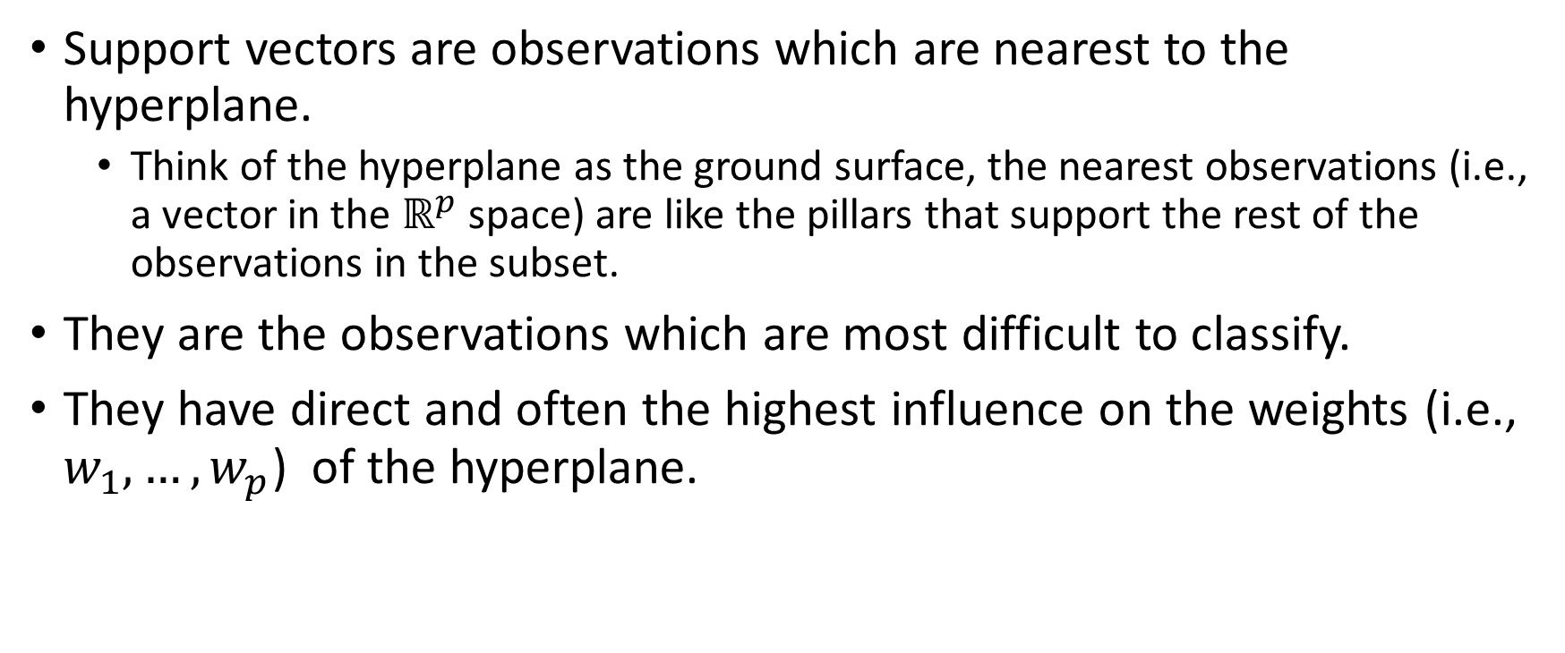
What are Support Vectors?
Support vectors are observations which are nearest to the hyperplane.
Think of the hyperplane as the ground surface, the nearest observations (i.e., a vector in the $ℝ^{p}$ space) are like the pillars that support the rest of the observations in the subset.
They are the observations which are most difficult to classify.
They have direct and often the highest influence on the weights (i.e., $w_{1},…,w_{p}$) of the hyperplane.

Slide 17
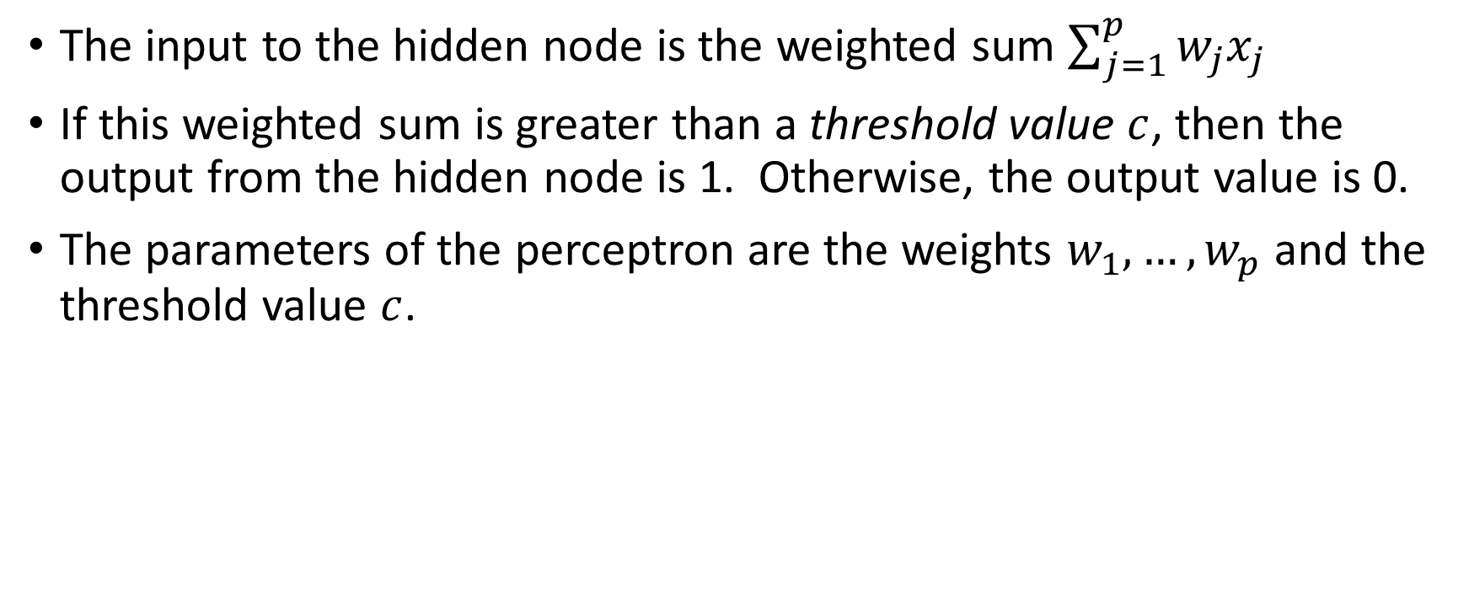
Perceptron Revisited: A Linear Separator
The input to the hidden node is the weighted sum $\sum_{j=1}^{p}{w_{j}x_{j}}$
If this weighted sum is greater than a threshold value $c$, then the output from the hidden node is 1. Otherwise, the output value is 0.
The parameters of the perceptron are the weights $w_{1},…,w_{p}$ and the threshold value $c$.

Slide 18
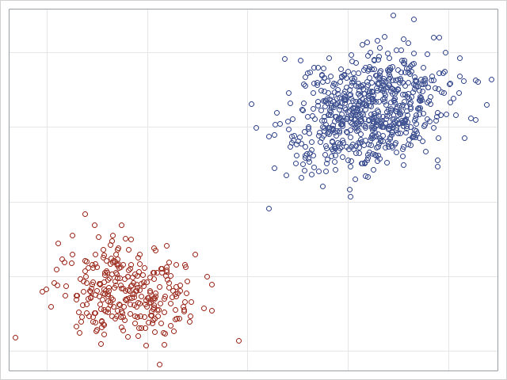
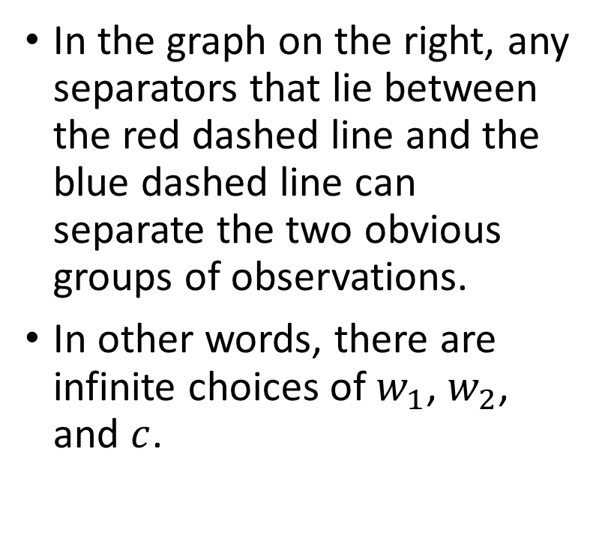
Which Linear Separator?
In the graph on the right, any separators that lie between the red dashed line and the blue dashed line can separate the two obvious groups of observations.
In other words, there are infinite choices of $w_{1}$, $w_{2}$, and $c$.

Slide 19
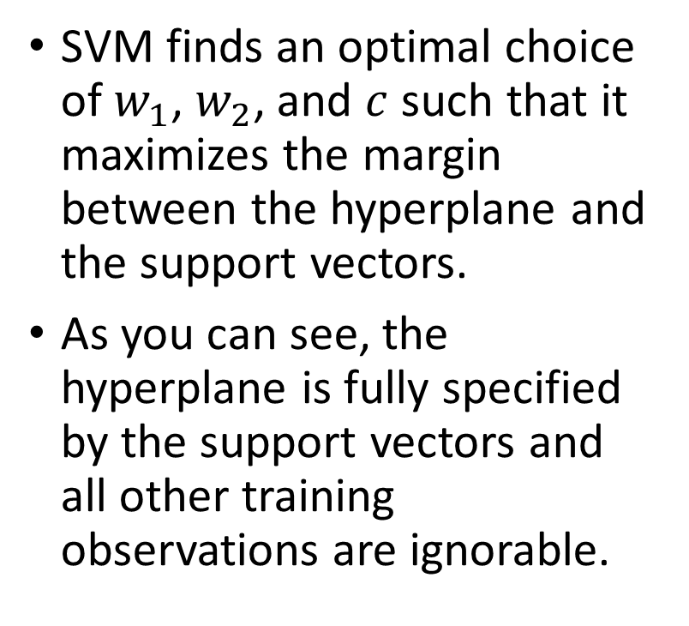
The Optimal Linear Separator
SVM finds an optimal choice of $w_{1}$, $w_{2}$, and $c$ such that it maximizes the margin between the hyperplane and the support vectors.
As you can see, the hyperplane is fully specified by the support vectors and all other training observations are ignorable.
Maximize Margin
Support Vectors

Slide 20
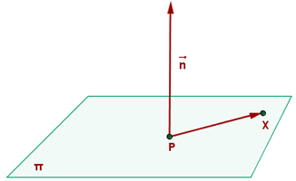
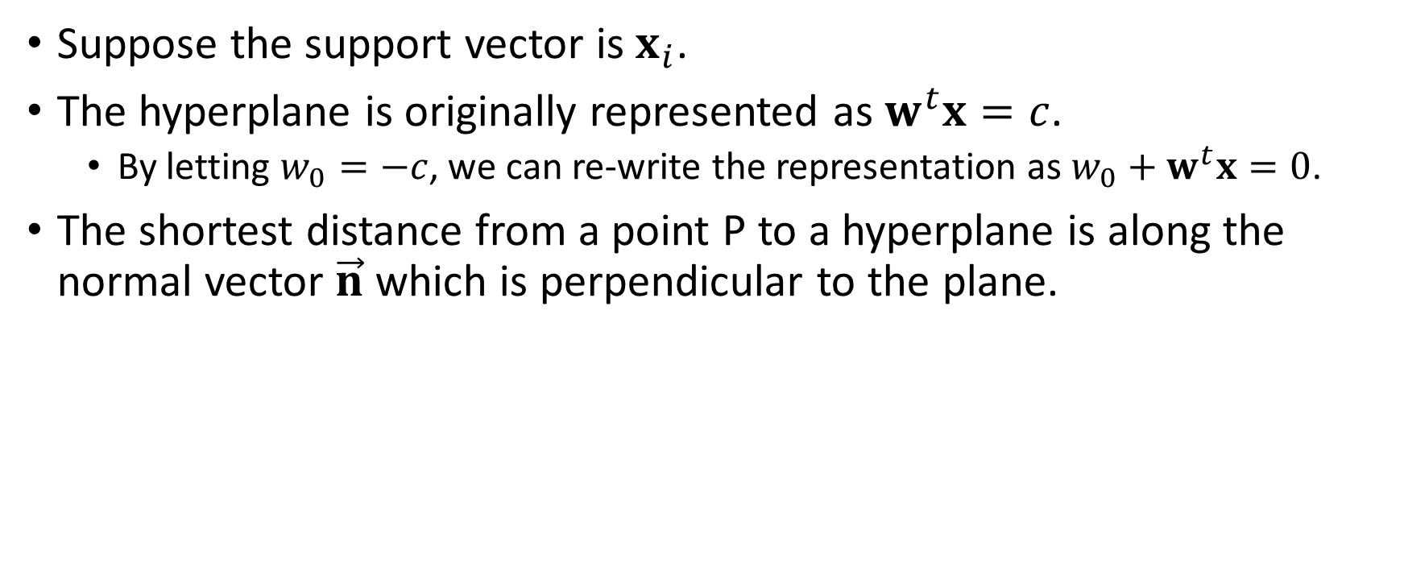
Distance from a Point to a Hyperplane
Suppose the support vector is $x_{i}$.
The hyperplane is originally represented as $w^{t}x=c$.
By letting $w_{0}=−c$, we can re-write the representation as $w_{0}+w^{t}x=0$.
The shortest distance from a point P to a hyperplane is along the normal vector $\vec{n}$ which is perpendicular to the plane.
Source: https://www.ditutor.com/space/normal_vector.html

Slide 21
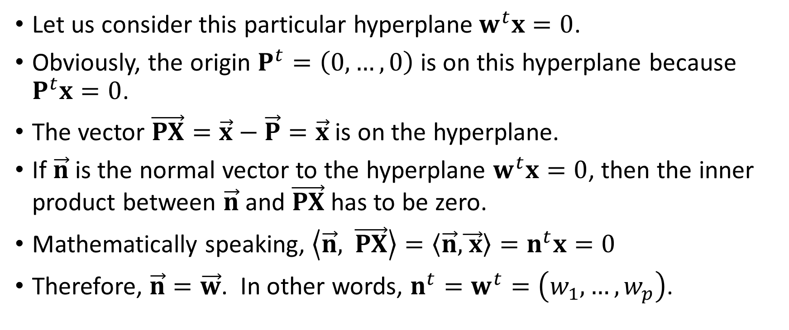
Normal Vector of a Hyperplane
Let us consider this particular hyperplane$w^{t}x=0$.
Obviously, the origin $P^{t}=\left(0,…,0\right)$ is on this hyperplane because $P^{t}x=0$.
The vector $\vec{PX}=\vec{x}−\vec{P}=\vec{x}$ is on the hyperplane.
If $\vec{n}$ is the normal vector to the hyperplane $w^{t}x=0$, then the inner product between $\vec{n}$ and $\vec{PX}$has to be zero.
Mathematically speaking, $\left\langle \vec{n}\text{,} \vec{PX}\right\rangle =\left\langle \vec{n}\text{,}\vec{ x}\right\rangle =n^{t}x=0$
Therefore, $\vec{n}=\vec{w}$. In other words, $n^{t}=w^{t}=\left(w_{1},…,w_{p}\right)$.

Slide 22
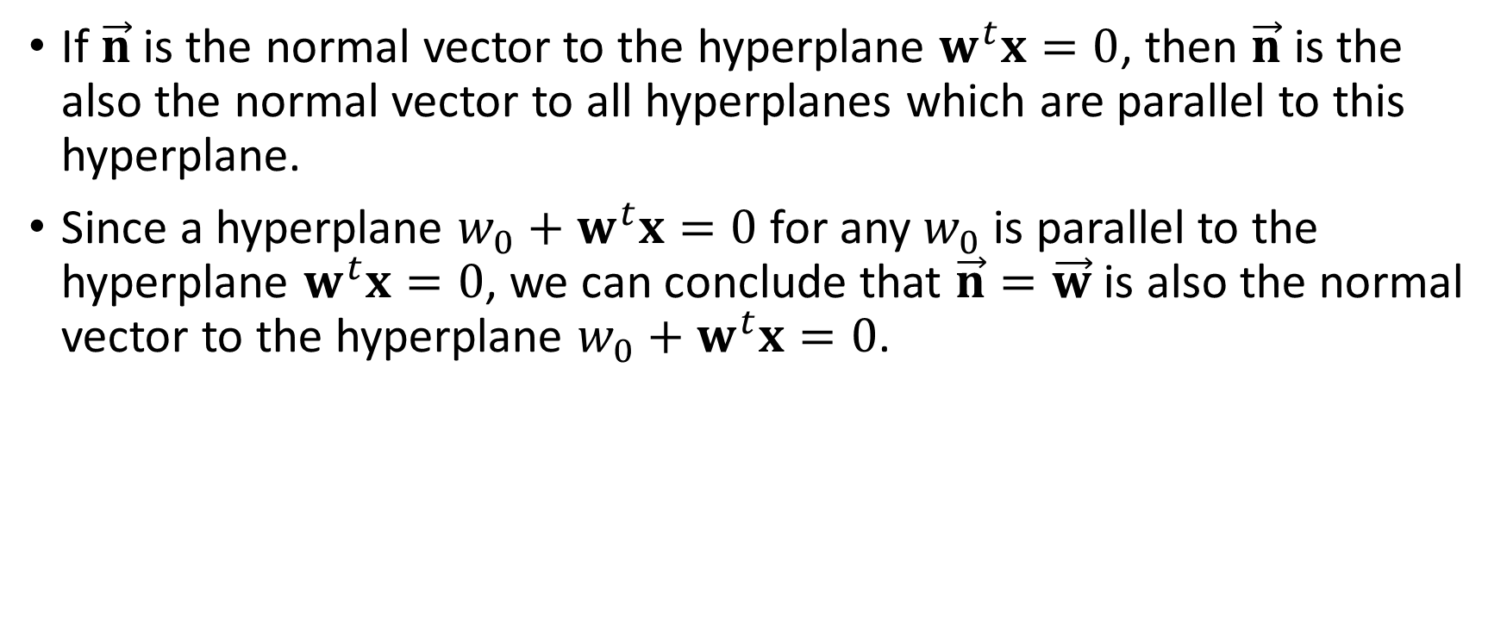
Normal Vector of a Hyperplane
If $\vec{n}$ is the normal vector to the hyperplane $w^{t}x=0$, then $\vec{n}$ is the also the normal vector to all hyperplanes which are parallel to this hyperplane.
Since a hyperplane $w_{0}+w^{t}x=0$ for any $w_{0}$ is parallel to the hyperplane $w^{t}x=0$, we can conclude that $\vec{n}=\vec{w}$ is also the normal vector to the hyperplane $w_{0}+w^{t}x=0$.

Slide 23
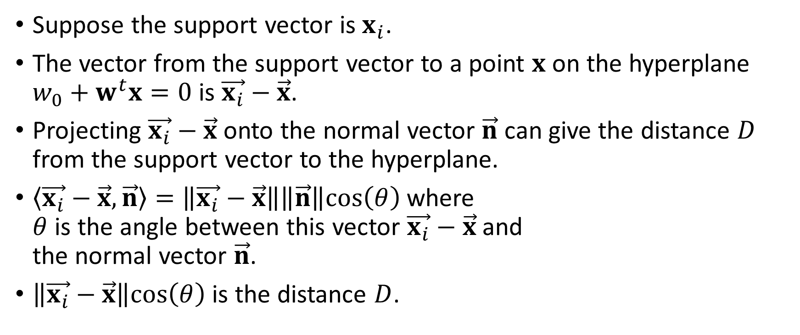

Distance from the Support Vector to a Hyperplane
Suppose the support vector is $x_{i}$.
The vector from the support vector to a point $x$ on the hyperplane $w_{0}+w^{t}x=0$ is $\vec{x_{i}}−\vec{x}$.
Projecting $\vec{x_{i}}−\vec{x}$ onto the normal vector $\vec{n}$ can give the distance $D$ from the support vector to the hyperplane.
$\left\langle \vec{x_{i}}−\vec{x}, \vec{n}\right\rangle =\left\|\vec{x_{i}}−\vec{x}\right\|\left\|\vec{n}\right\|cos\left(θ\right)$ where $θ$ is the angle between this vector $\vec{x_{i}}−\vec{x}$ and the normal vector $\vec{n}$.
$\left\|\vec{x_{i}}−\vec{x}\right\|cos\left(θ\right)$ is the distance $D$.
$$x_{i}$$

Slide 24
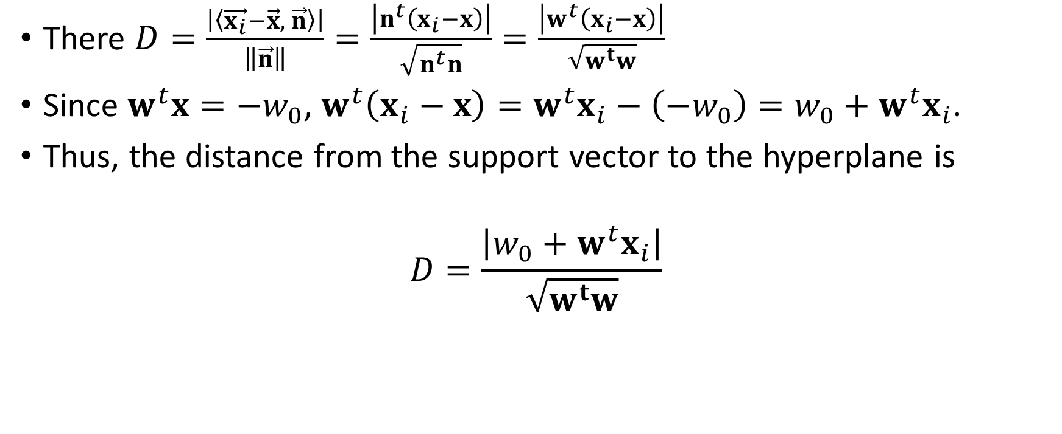
Distance from the Support Vector to a Hyperplane
There $D=\frac{\left|\left\langle \vec{x_{i}}−\vec{x}, \vec{n}\right\rangle \right|}{\left\|\vec{n}\right\|}=\frac{\left|n^{t}\left(x_{i}−x\right)\right|}{\sqrt{n^{t}n}}=\frac{\left|w^{t}\left(x_{i}−x\right)\right|}{\sqrt{w^{t}w}}$
Since $w^{t}x=−w_{0}$, $w^{t}\left(x_{i}−x\right)=w^{t}x_{i}−\left(−w_{0}\right)=w_{0}+w^{t}x_{i}$.
Thus, the distance from the support vector to the hyperplane is
$$D=\frac{\left|w_{0}+w^{t}x_{i}\right|}{\sqrt{w^{t}w}}$$
Source: https://www.ditutor.com/space/normal_vector.html

Slide 25
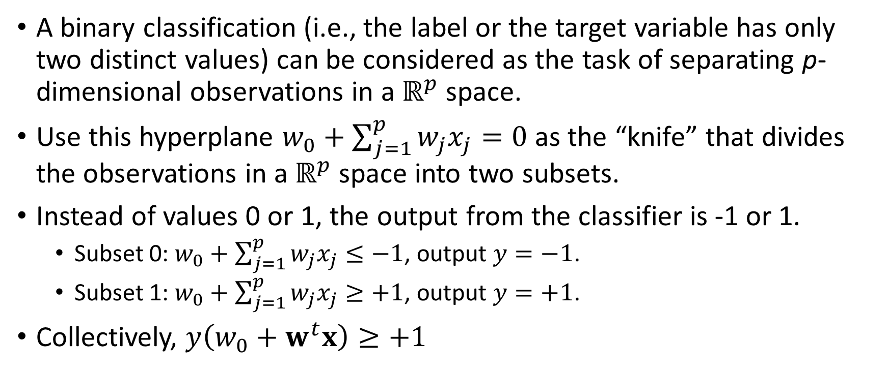
From Perceptron to Support Vector Machines
A binary classification (i.e., the label or the target variable has only two distinct values) can be considered as the task of separating p-dimensional observations in a $ℝ^{p}$ space.
Use this hyperplane $w_{0}+\sum_{j=1}^{p}{w_{j}x_{j}=0}$ as the “knife” that divides the observations in a $ℝ^{p}$ space into two subsets.
Instead of values 0 or 1, the output from the classifier is -1 or 1.
Subset 0: $w_{0}+\sum_{j=1}^{p}{w_{j}x_{j}≤−1}$, output $y=−1$.
Subset 1: $w_{0}+\sum_{j=1}^{p}{w_{j}x_{j}≥+1}$, output $y=+1$.
Collectively, $y\left(w_{0}+w^{t}x\right)≥+1$

Slide 26
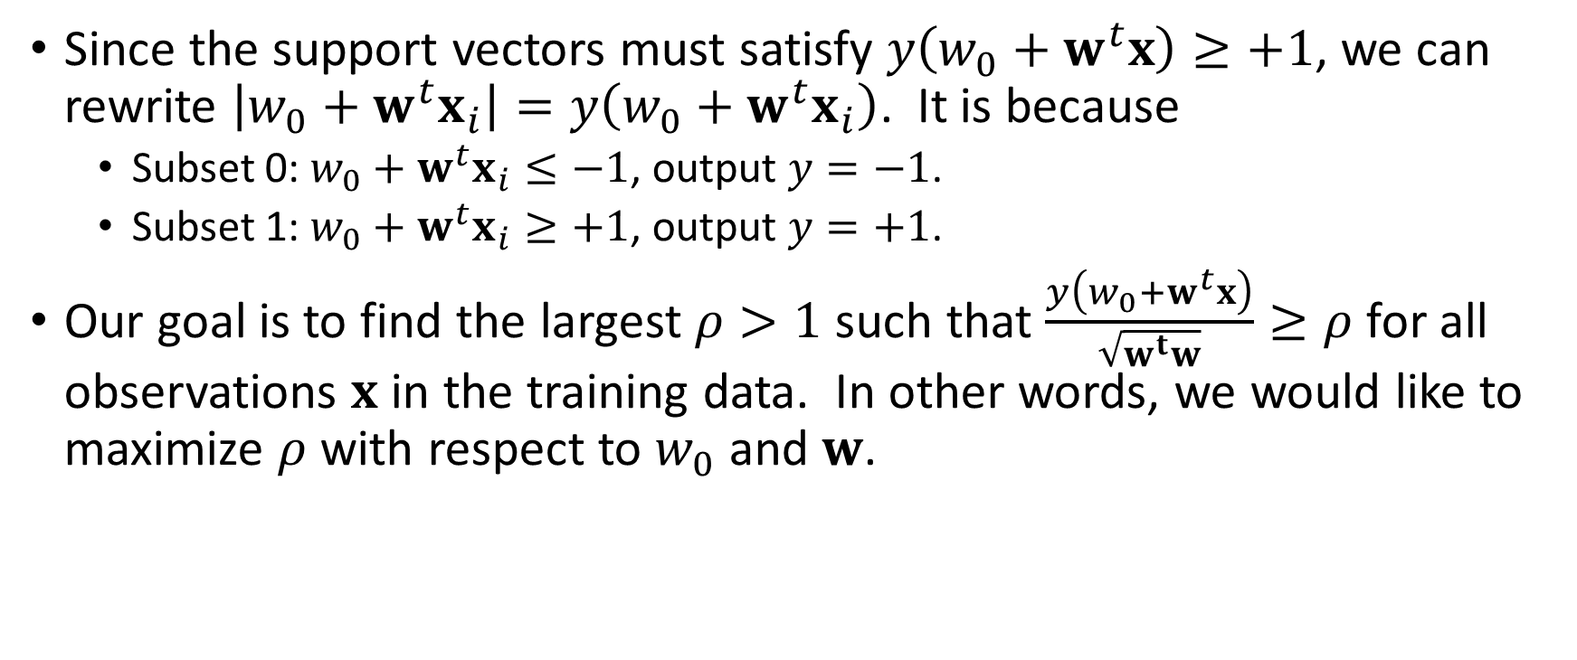
Maximizing the Margin
Since the support vectors must satisfy $y\left(w_{0}+w^{t}x\right)≥+1$, we can rewrite $\left|w_{0}+w^{t}x_{i}\right|=y\left(w_{0}+w^{t}x_{i}\right)$. It is because
Subset 0: $w_{0}+w^{t}x_{i}≤−1$, output $y=−1$.
Subset 1: $w_{0}+w^{t}x_{i}≥+1$, output $y=+1$.
Our goal is to find the largest $ρ>1$ such that $\frac{y\left(w_{0}+w^{t}x\right)}{\sqrt{w^{t}w}}≥ρ$ for all observations $x$ in the training data. In other words, we would like to maximize $ρ$ with respect to $w_{0}$ and $w$.

Slide 27
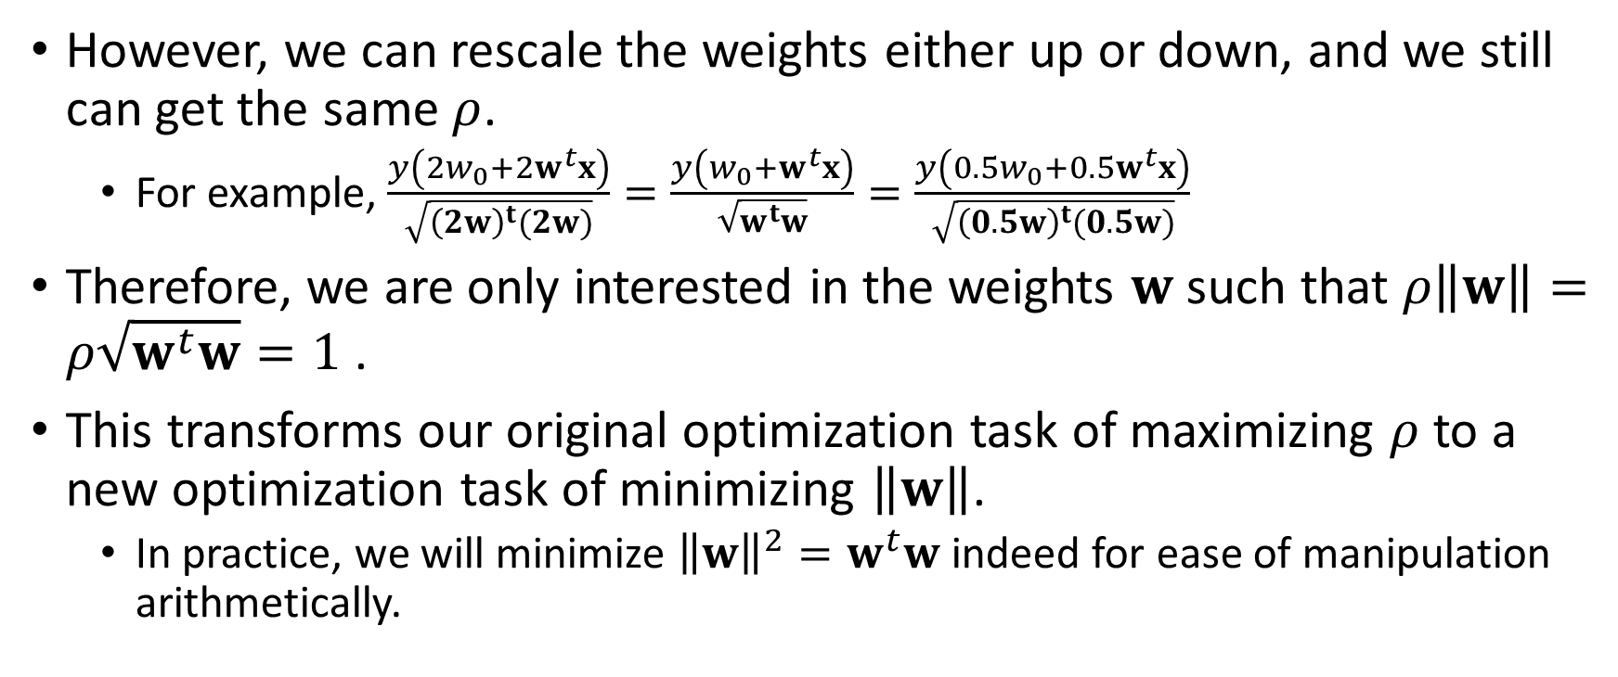
Minimizing the Norm of the Weights
However, we can rescale the weights either up or down, and we still can get the same $ρ$.
For example, $\frac{y\left(2w_{0}+2w^{t}x\right)}{\sqrt{{\left(2w\right)}^{t}(2w)}}=\frac{y\left(w_{0}+w^{t}x\right)}{\sqrt{w^{t}w}}=\frac{y\left(0.5w_{0}+0.5w^{t}x\right)}{\sqrt{{\left(0.5w\right)}^{t}(0.5w)}}$
Therefore, we are only interested in the weights $w$ such that $ρ\left\|w\right\|=ρ\sqrt{w^{t}w}=1$ .
This transforms our original optimization task of maximizing $ρ$ to a new optimization task of minimizing $\left\|w\right\|$.
In practice, we will minimize ${\left\|w\right\|}^{2}=w^{t}w$ indeed for ease of manipulation arithmetically.

Slide 28
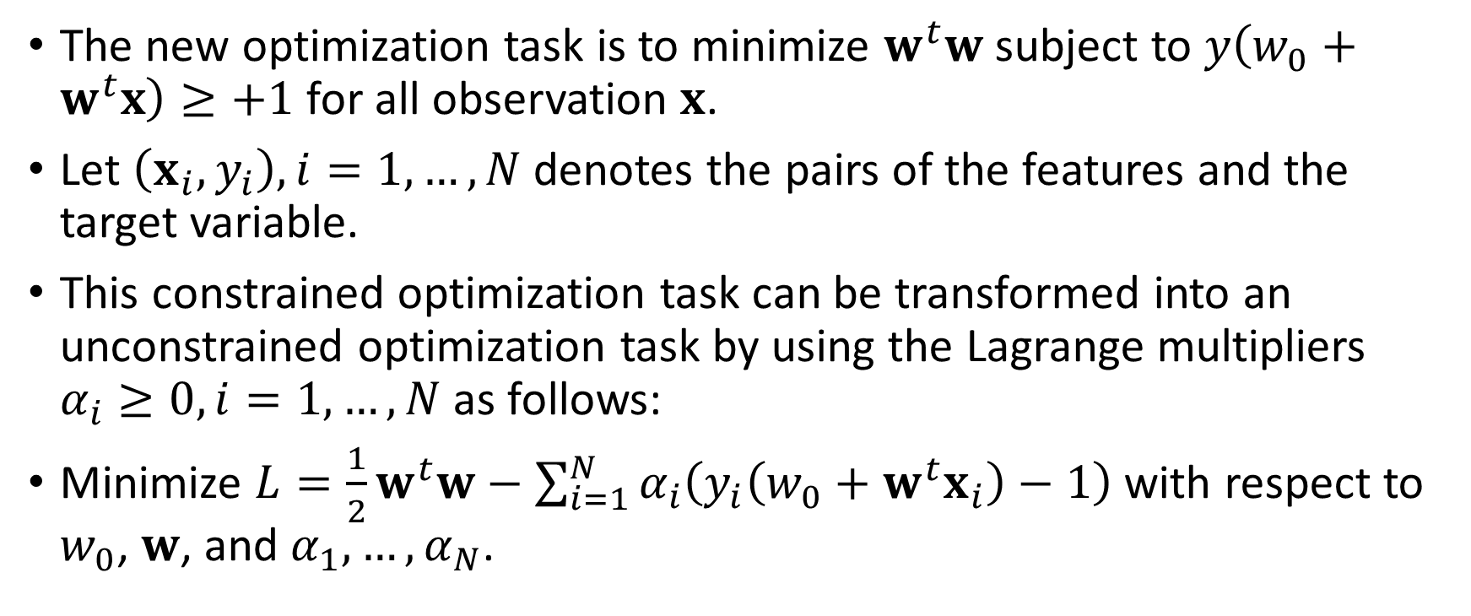
The Unconstrained Minimization Problem
The new optimization task is to minimize $w^{t}w$ subject to $y\left(w_{0}+w^{t}x\right)≥+1$ for all observation $x$.
Let $\left(x_{i},y_{i}\right),i=1,…,N$ denotes the pairs of the features and the target variable.
This constrained optimization task can be transformed into an unconstrained optimization task by using the Lagrange multipliers $α_{i}≥0, i=1,…,N$ as follows:
Minimize $L=\frac{1}{2}w^{t}w−\sum_{i=1}^{N}{α_{i}\left(y_{i}\left(w_{0}+w^{t}x_{i}\right)−1\right)}$ with respect to $w_{0}$, $w$, and $α_{1},…,α_{N}$.

Slide 29
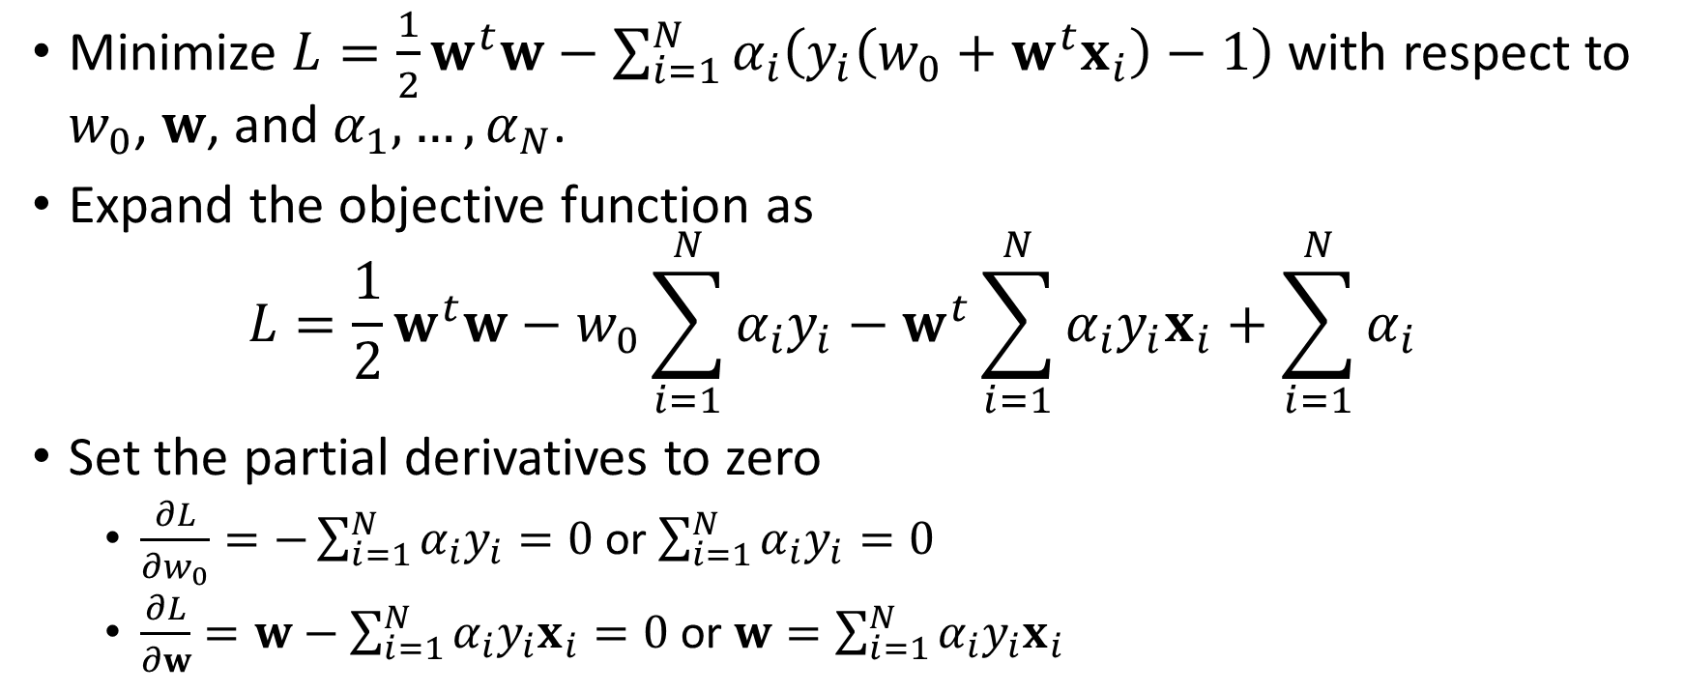
The Unconstrained Minimization Problem
Minimize $L=\frac{1}{2}w^{t}w−\sum_{i=1}^{N}{α_{i}\left(y_{i}\left(w_{0}+w^{t}x_{i}\right)−1\right)}$ with respect to $w_{0}$, $w$, and $α_{1},…,α_{N}$.
Expand the objective function as $L=\frac{1}{2}w^{t}w−w_{0}\sum_{i=1}^{N}{α_{i}y_{i}}−w^{t}\sum_{i=1}^{N}{α_{i}y_{i}x_{i}}+\sum_{i=1}^{N}{α_{i}}$
Set the partial derivatives to zero
$\frac{∂L}{∂w_{0}}=−\sum_{i=1}^{N}{α_{i}y_{i}}=0$ or $\sum_{i=1}^{N}{α_{i}y_{i}}=0$
$\frac{∂L}{∂w}=w−\sum_{i=1}^{N}{α_{i}y_{i}x_{i}}=0$ or $w=\sum_{i=1}^{N}{α_{i}y_{i}x_{i}}$

Slide 30
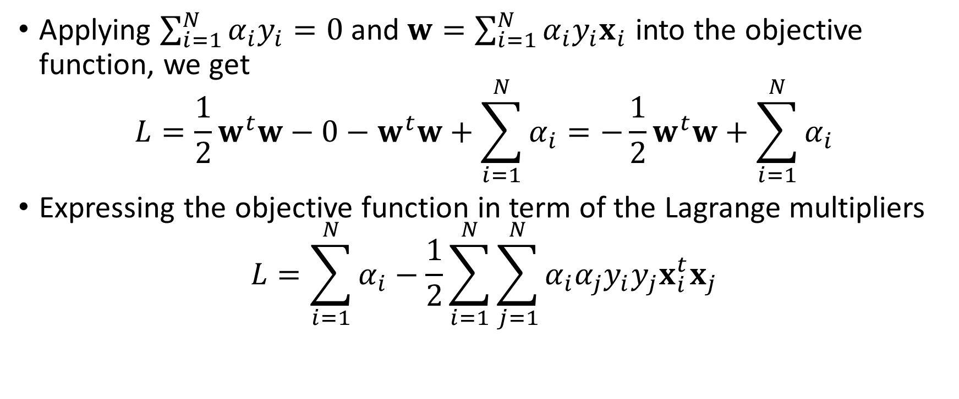
The Unconstrained Minimization Problem
Applying $\sum_{i=1}^{N}{α_{i}y_{i}}=0$ and $w=\sum_{i=1}^{N}{α_{i}y_{i}x_{i}}$ into the objective function, we get
$$L=\frac{1}{2}w^{t}w−0−w^{t}w+\sum_{i=1}^{N}{α_{i}}=−\frac{1}{2}w^{t}w+\sum_{i=1}^{N}{α_{i}}$$
Expressing the objective function in term of the Lagrange multipliers
$$L=\sum_{i=1}^{N}{α_{i}}−\frac{1}{2}\sum_{i=1}^{N}{\sum_{j=1}^{N}{α_{i}α_{j}y_{i}y_{j}x_{i}^{t}x_{j}}}$$

Slide 31
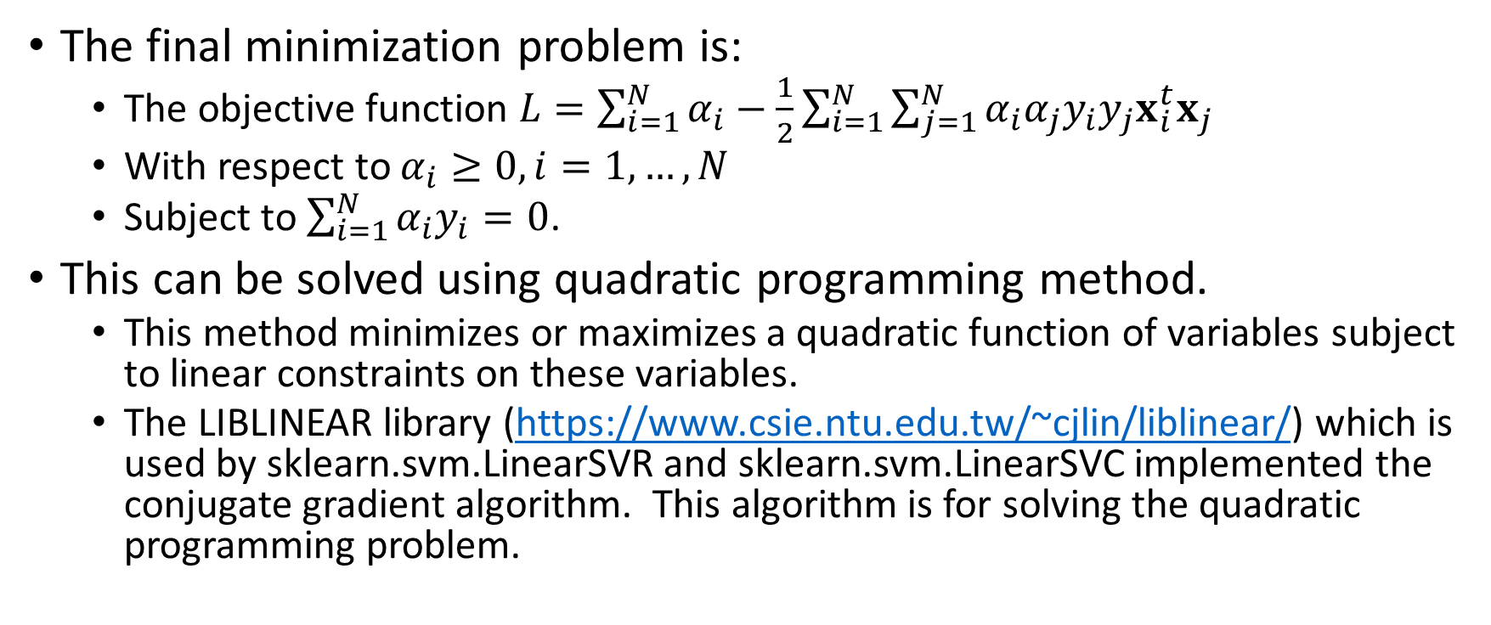
The Unconstrained Minimization Problem
The final minimization problem is:
The objective function $L=\sum_{i=1}^{N}{α_{i}}−\frac{1}{2}\sum_{i=1}^{N}{\sum_{j=1}^{N}{α_{i}α_{j}y_{i}y_{j}x_{i}^{t}x_{j}}}$
With respect to $α_{i}≥0,i=1,…,N$
Subject to $\sum_{i=1}^{N}{α_{i}y_{i}}=0$.
This can be solved using quadratic programming method.
This method minimizes or maximizes a quadratic function of variables subject to linear constraints on these variables.
The LIBLINEAR library (https://www.csie.ntu.edu.tw/~cjlin/liblinear/) which is used by sklearn.svm.LinearSVR and sklearn.svm.LinearSVC implemented the conjugate gradient algorithm. This algorithm is for solving the quadratic programming problem.

Slide 32
A Supervised Classification Problem
Let us try the sklearn.svm.LinearSVC for classifying the toy data.
Mean accuracy = 0.977
Intercept = -0.53415939
Weights coefficients = [[-0.92853733 -0.68382709]]

Slide 33
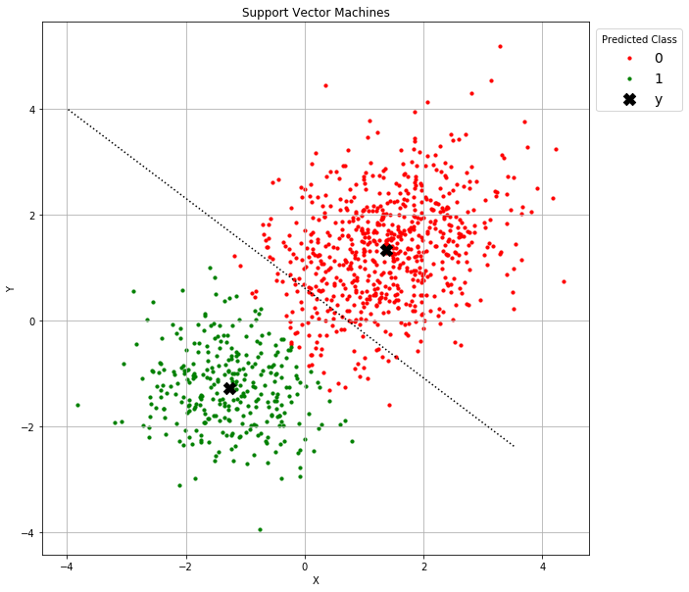
A Supervised Classification Problem
The hyperplane (which is the dotted line in the graph on the right) is -0.92853733 * x -0.68382709 * y = -0.53415939
The means of the predicted class, marked X in the chart, are: [[ 1.374464 1.338855] [-1.272702 -1.280386]]
How successful do you think the hyperplane in dividing the two populations?

Slide 34
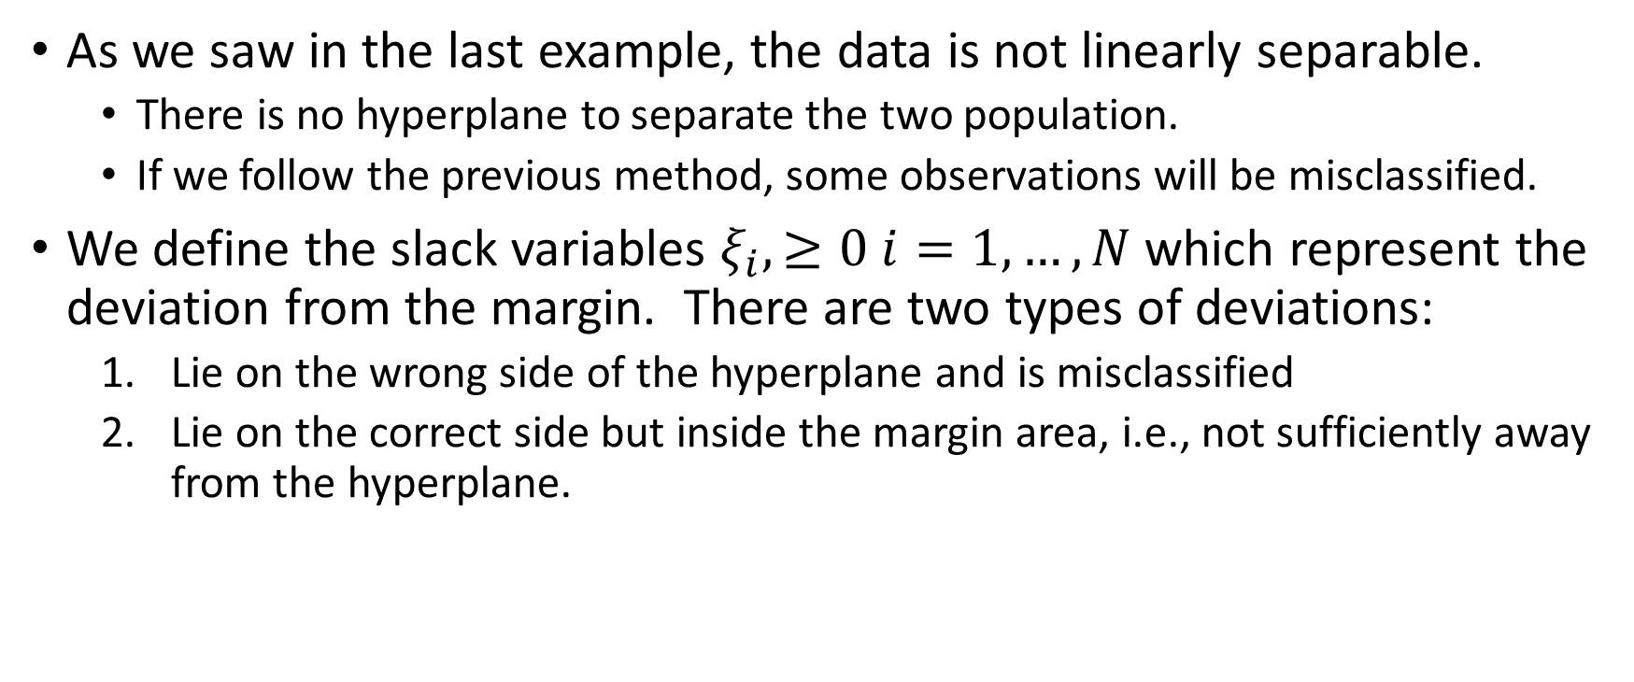
The Non-separable Case
As we saw in the last example, the data is not linearly separable.
There is no hyperplane to separate the two population.
If we follow the previous method, some observations will be misclassified.
We define the slack variables $ξ_{i},≥0 i=1,…,N$ which represent the deviation from the margin. There are two types of deviations:
Lie on the wrong side of the hyperplane and is misclassified
Lie on the correct side but inside the margin area, i.e., not sufficiently away from the hyperplane.

Slide 35
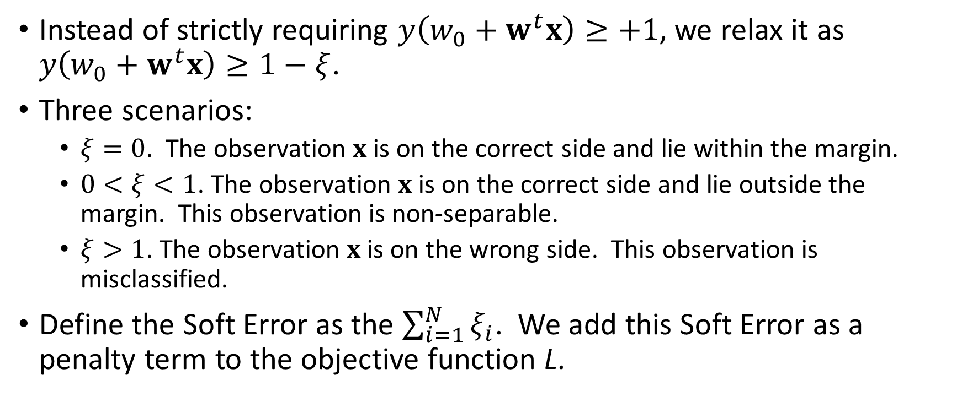
The Non-separable Case
Instead of strictly requiring $y\left(w_{0}+w^{t}x\right)≥+1$, we relax it as $y\left(w_{0}+w^{t}x\right)≥1−ξ$.
Three scenarios:
$ξ=0$. The observation $x$ is on the correct side and lie within the margin.
$0<ξ<1$. The observation $x$ is on the correct side and lie outside the margin. This observation is non-separable.
$ξ>1$. The observation $x$ is on the wrong side. This observation is misclassified.
Define the Soft Error as the $\sum_{i=1}^{N}{ξ_{i}}$. We add this Soft Error as a penalty term to the objective function L.

Slide 36
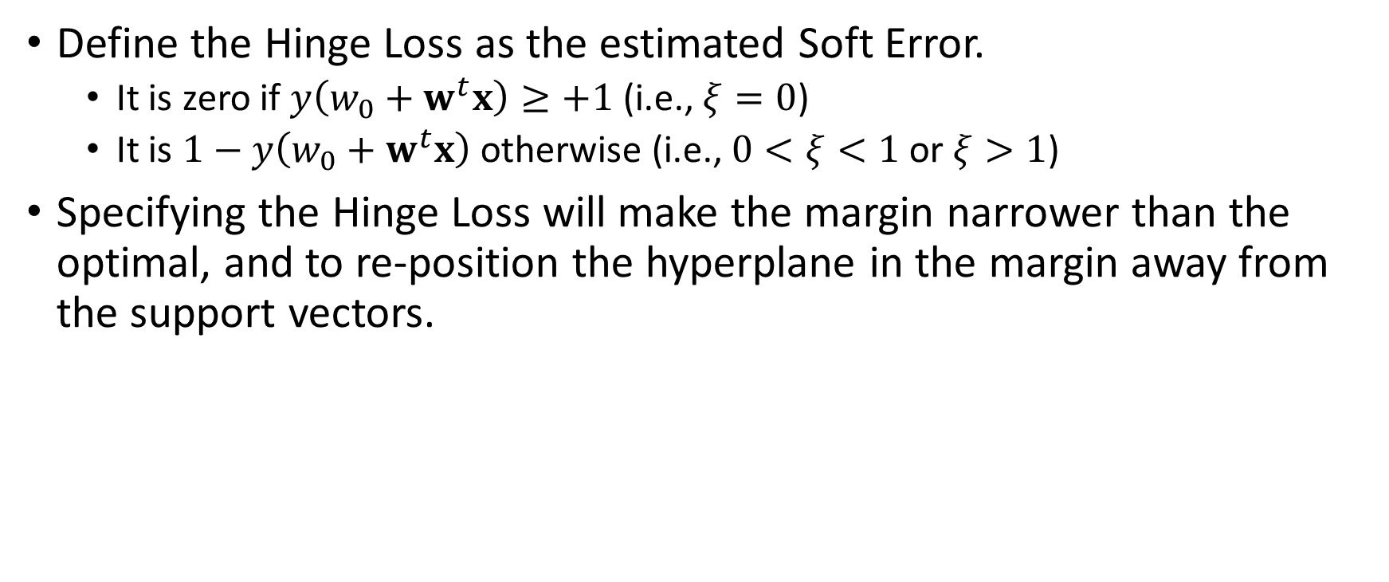
The Non-separable Case
Define the Hinge Loss as the estimated Soft Error.
It is zero if $y\left(w_{0}+w^{t}x\right)≥+1$ (i.e., $ξ=0$)
It is $1−y\left(w_{0}+w^{t}x\right)$ otherwise (i.e., $0<ξ<1$ or $ξ>1$)
Specifying the Hinge Loss will make the margin narrower than the optimal, and to re-position the hyperplane in the margin away from the support vectors.

Slide 37
Multi-Class Target Variable
If the label or the target variable has more than two categories, the classification can be done in:
One class versus another class. One SVM classifier for each pair of classes.
One class versus all the other classes. One SVM classifier for each pair of a class versus the otherwise.
Crammer-Singer method. Koby Crammer and Yoram Singer (2001). "On the Algorithmic Implementation of Multiclass Kernel-based Vector Machines". Journal of Machine Learning Research, 2, 265-292.

Slide 38
Final Remarks
Support Vector Machines are primarily for classification of a binary target variable.
In addition to classification, Support Vector Machines provide the line in the sand. The line ensures that the margin between the line and the support vectors are widest. This helps the prediction of new data.

Slide 39
Assignment 5
Will be posted before the end of Friday November 9, 2018
Due date is 11:59 pm on Sunday November 18, 2018

Slide 40
Office Hours
Instructor, Dr. Lam
mlam5@iit.edu
Mondays / 4 PM to 5 PM / Room 228A, Stuart Building
Except for the Fall Break on October 8
Teaching Assistant, Mr. Jing Zhao
jzhao29@hawk.iit.edu
Thursdays / 2 PM to 3 PM / Room 019A, Stuart Building

